Slide 1
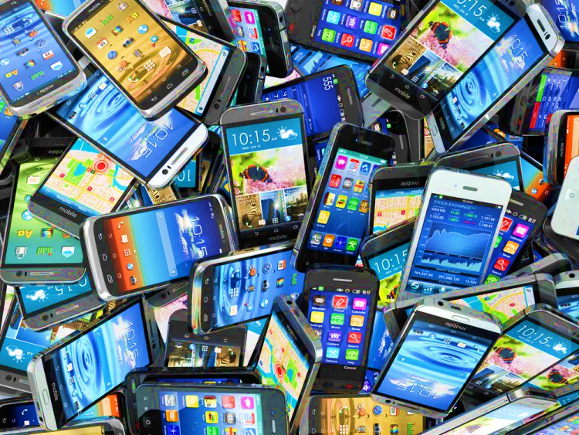
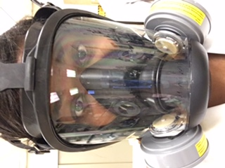
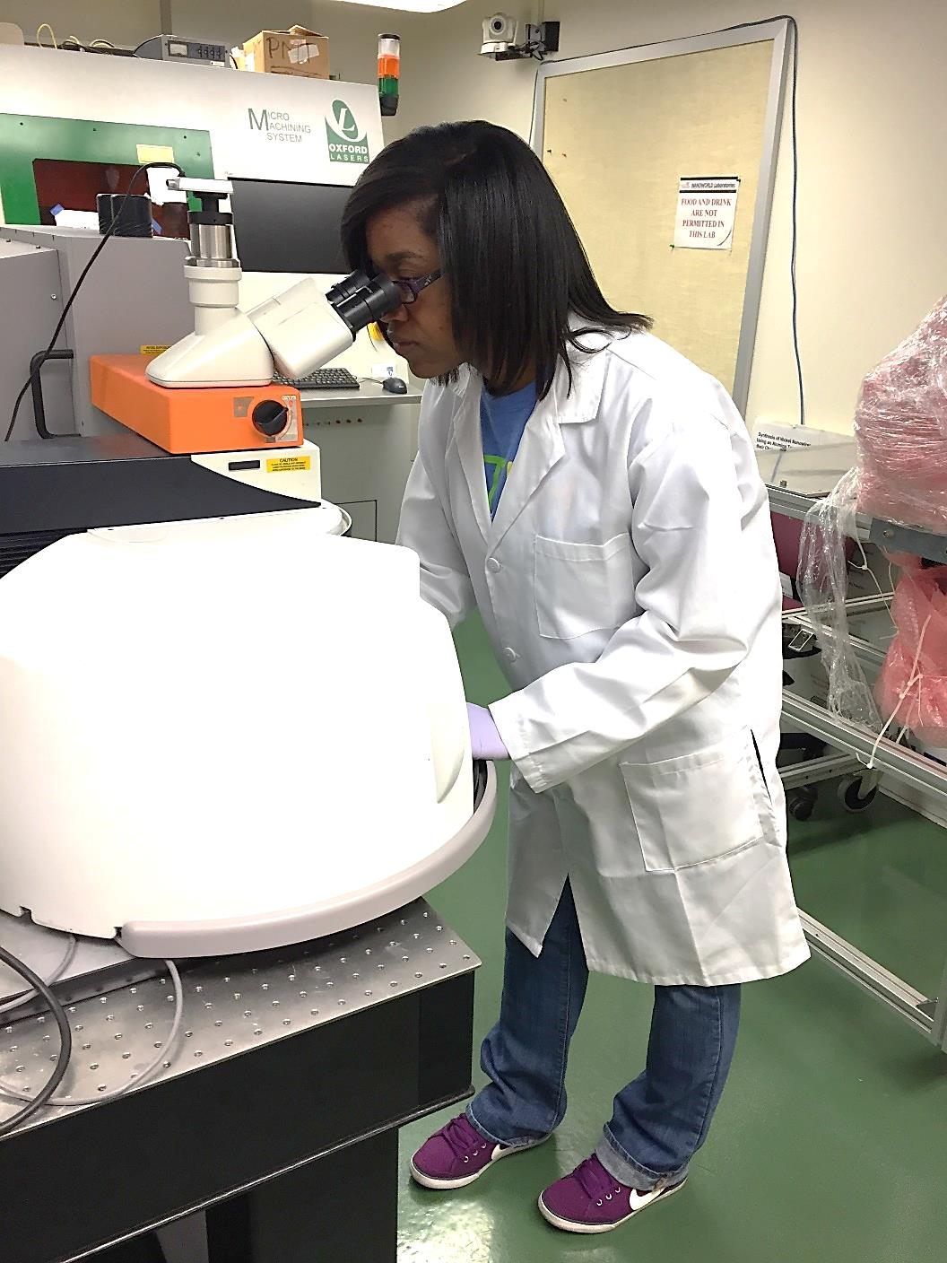
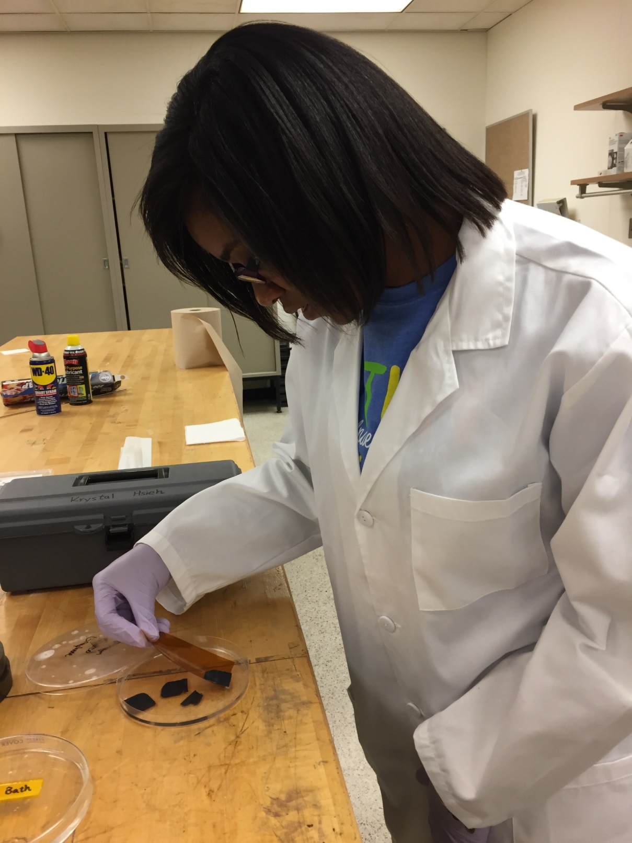
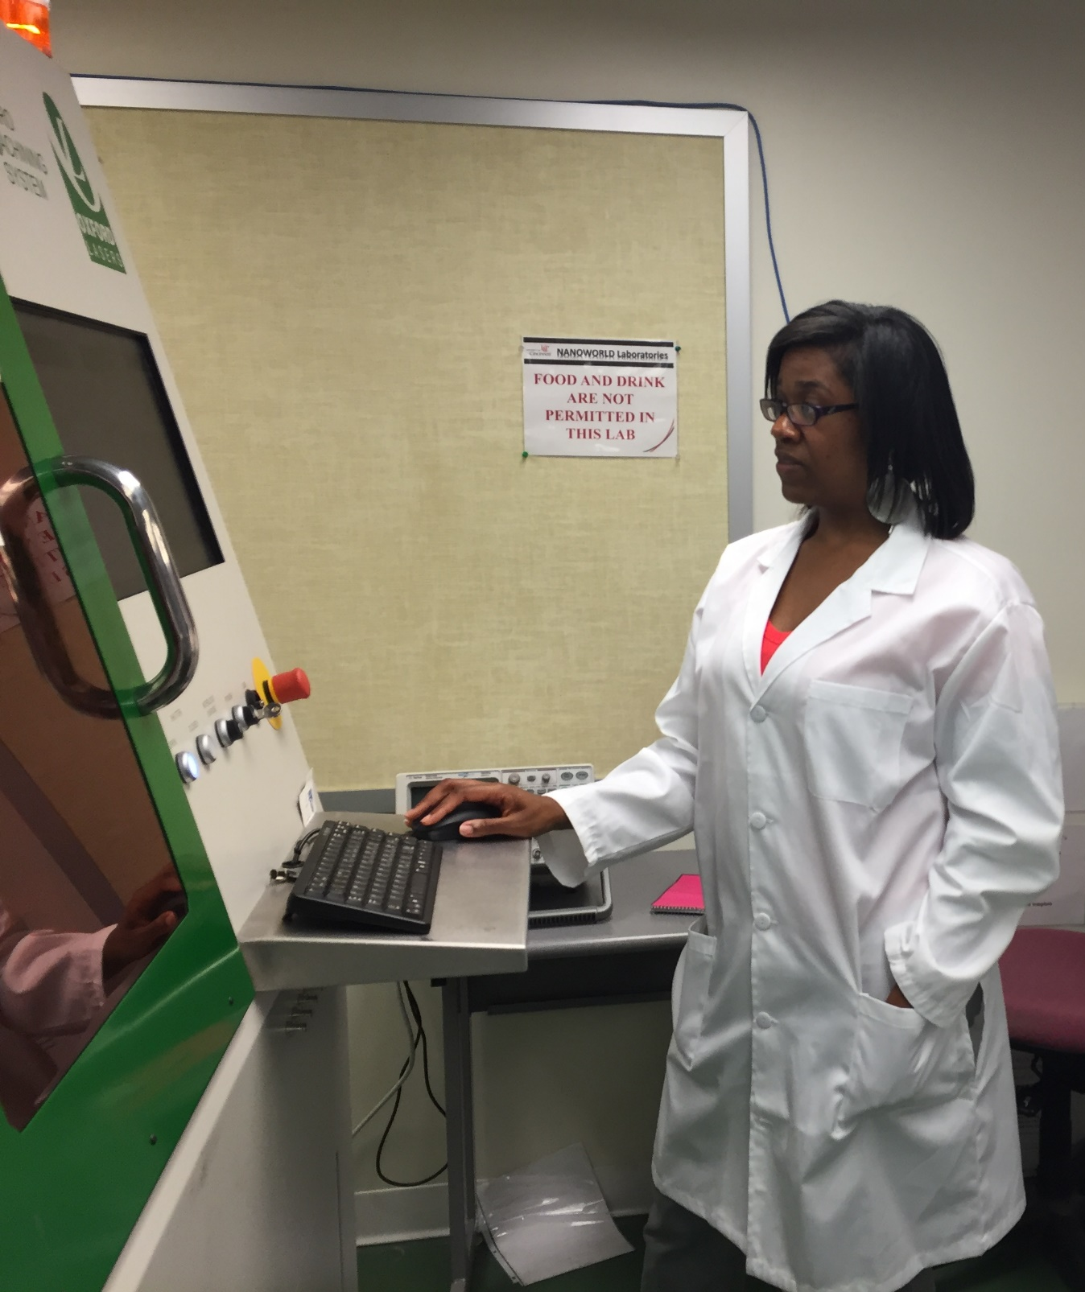
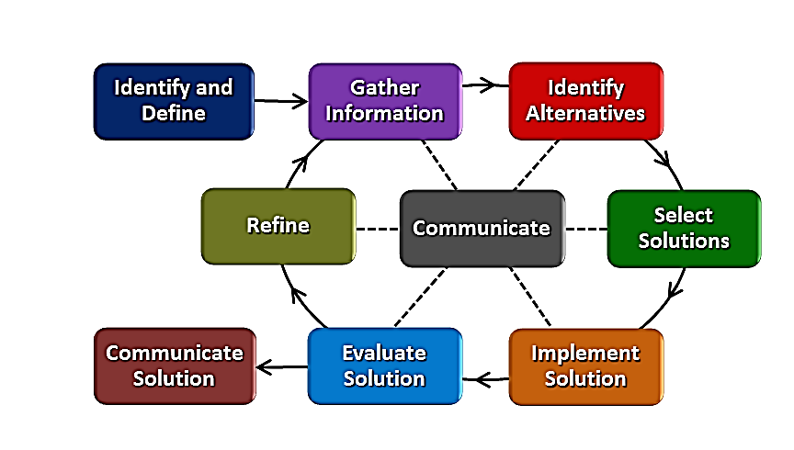
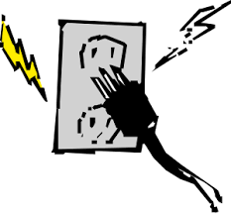
Battery Blues Tiara Anderson Purcell Marian High School, Integrated Math I, 9th Grade
RET is funded by the National Science Foundation, grant
# EEC-1404766
What did I do?
What will we do?
What should we think about?
Research Project:
Improving Energy Storage Devices
By Investigating Lithium Sulfur Batteries
BIG IDEA
How can we THINK like engineers?
COAL
Chemical Energy
Storage
LIMITED SUPPLY!!!
Research group at NanoWorld Laboratories of UC aspires to create a rechargeable battery meeting these constraints:
See a need, fill a need
Brainstorm innovative solutions
Work as a team
Learn from failure
Refine solutions
Communicate best solution
THERMAL ENERGY
WATER & STEAM
Heat Energy Storage
KINETIC ENERGY
Safe for the environment and consumers
Low cost of manufacturing
Hold great amount of energy
Hold charge for a week’s length of time
Charge within seconds!!!
TURBINE
KINETIC ENERGY
Engineering Design Process
GENERATOR
ELECTRIC ENERGY
http://sharpenet.com/give-take/think-print-is-dead-think-again/
http://www.keepcalmandposters.com/poster/4444010_keep_calm_and_think_like_an_engineer
1) http://www.wkow.com/story/14696334/special-report-theres-an-app-for-that
2) https://www.pinterest.com/chan2216/conserve-energy/ 3) http://completeelectrical.biz/outlet-sparks/
4)http://www.clipartpanda.com/categories/coal-clip-art 5) http://www.freeclipart.pw/clipart_images/steam-cloud-clipart-25079
6) http://all-free-download.com/free-vector/download/wind-turbine-clip-art_15577.html
Notes:
Panel 3: http://www.wkow.com/story/14696334/special-report-theres-an-app-for-that
http://guernseydonkey.com/?p=7430, https://www.pinterest.com/chan2216/conserve-energy/
http://completeelectrical.biz/outlet-sparks/
http://www.clipartpanda.com/categories/coal-clip-art
http://www.freeclipart.pw/clipart_images/steam-cloud-clipart-25079
http://all-free-download.com/free-vector/download/wind-turbine-clip-art_15577.html
Panel 2:
http://sharpenet.com/give-take/think-print-is-dead-think-again/
http://www.keepcalmandposters.com/poster/4444010_keep_calm_and_think_like_an_engineer

